Slide 1
Worsening cHF – When to Phone a Friend
Jaime G. Watkins, MSN, FNP-C
Baptist Heart Transplant and Mechanical Circulatory Support Center

Slide 2

Financial Disclosers
No Financial or Commercial Interest to Disclose

Slide 3
A Tale of Two Patients
Patient A
Patient B
68 y/o female. Hx: HTN, CHF, CRD, DM
EF 25-30%, Non-ischemic CM,
Carvedilol 3.25 mg, Furosemide 40 mg BID, Amlodipine 5 mg
c/o increased LE edema, DOE with any activity
68 y/o famale Hx: HTN, CHF, CRD, DM
EF 20-25%, Ischemic CM
Carvedilol 3.25 mg, Furosemide 80 BID
c/o decreased energy, decreased appetite, N/V, abdominal distention

Slide 4

A Tale of Two Patients
One could argue that both patients would be appropriate for referral to an Advanced Heart Failure clinic…
We need more information…What tips the balance?

Slide 5
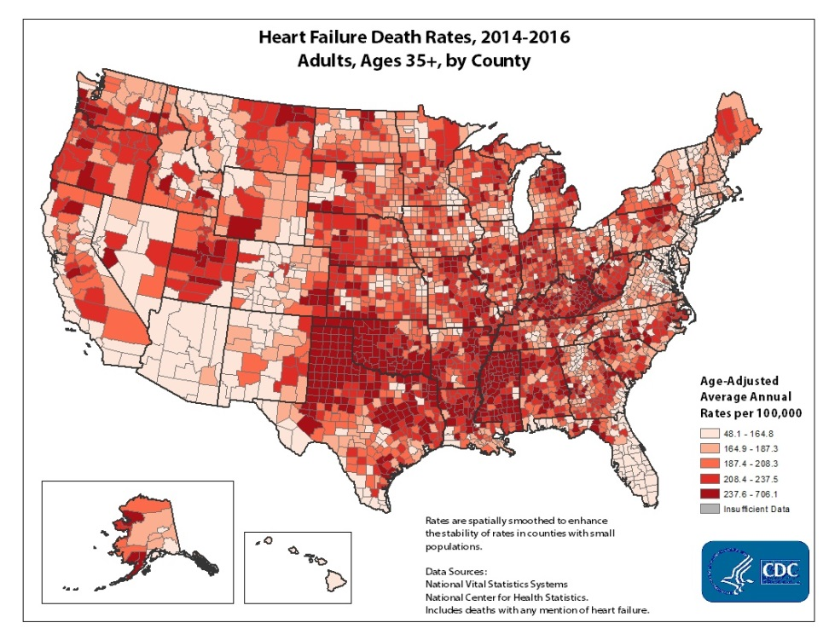
Addressing an Unmet Need

Slide 6
The VAD and Heart Transplant patient population is approaching 100,000 in the United States alone.
US population¹
Target population (35-74 age cohort)¹
Diagnosed CHF population²
All ages
35-74
NYHA Class IIIB and IV³ in 35-74 age cohort
Comorbidities estimated in this cohort
Target VAD and Heart TX patient population (35-74 years)
301,000,000
139,100,000
5,520,000
3,744,000
374,400
(280,800)
93,600
1 US Census Bureau Statistics (2007)
2 Heart and Stroke Statistics, American Heart Association
3 Cardiovascular Round Table research and analysis, The Advisory Board company (2009)

Slide 7
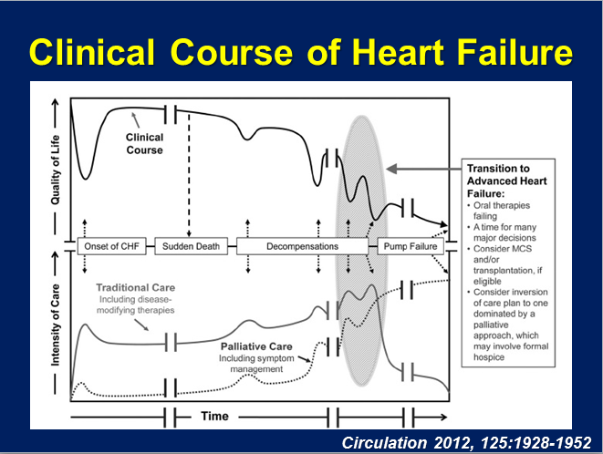
Notes:
Assumptions: EF <25%, treated with GDMT or failing, Therapy for 45 of 60 days or IABP for 7 days

Slide 8
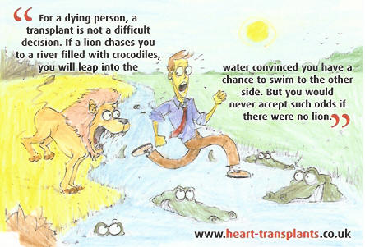
Perspective

Slide 9
Referral for Advanced Heart Failure Therapies
NYHA Class III or IV
EF </= 20-25%
CAD with no options for surgical revascularization
Failing optimal medical therapy
Inability to walk 1 block without SOB
CPX – MVO2 <14 with max work effort
Intolerant or Refractory to ACEI, ARBs or Beta Blockers
1 or more CHF hospital admissions in last 12 months
Cardiac Resynchronization Therapy non-responder
High diuretic dose (>120mg/d)

Slide 10
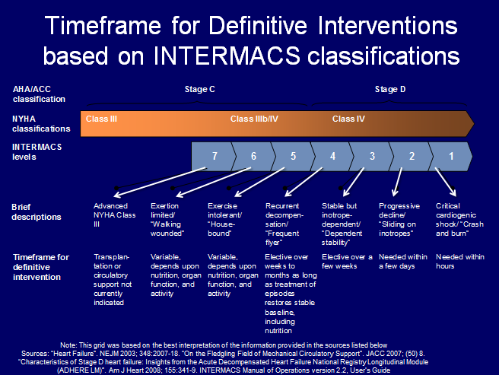

Slide 11
A New Mnemonic
Inotropes – previous or ongoing dobutamine, milrinone
NYHA class III or IV
End-organ dysfunction – worsening renal dysfunction in setting of HF
Ejection Fraction - </= 20%
Defibrillator shocks – Recurrent appropriate ICD shocks
Hospitalizations – >1 HF hospitalization in 12 months
Edema/escalating diuretics – persistent fluid overload
Low BP – consistently low BP, inability to tolerate HF therapy
Prognostic medication – inability to up-titrate or need to decrease/discontinue (ACEI, BB, ARNI)

Slide 12
A Tale of Two Patients
Patient A
Patient B
BP 118/80, HR 77, wt +10 since last visit
BUN/Creat: 24/1.35, ProBNP 4,127
Reports she missed furosemide for past 4 days because she didn’t have a ride to pharmacy and admits that she doesn’t restrict fluids or sodium very well
Exam: 2+ BLE edema extends to mid-shins, breath sounds are decreased to bases, no JVD
BP 90/68, HR 107
BUN/Creat: 21/1.85, ProBNP 4,675
Reports DOE with any activity, decreased energy, denies lower ext. edema any worse, compliant with medication regimen, fluid and sodium restriction
Exam: 2+edema to mid-shins, crackles in bases, +JVD, difficult to lie flat during exam
Notes:
Patient B was unable to tolerate low dose Entresto and has required decreasing dosing of carvedilol. She is Intermacs class 4 slipping to 3. Meets several of the I NEED HELP identifiers. While Patient A may have potential for “tuning up” with taking medications according to recommendation and perhaps some heart failure education. We are happy to see either patient but Patient A could potentially be “too well” and could be sent back to you for ongoing follow-up and referral at a later time.

Slide 13
Referral to BMH-Transplant/MCS
Initial Clinic Visit
Insurance Approval
Review Records
?Absolute Rule Outs

Slide 14

Two roads diverged in a yellow wood, And sorry I could not travel both And be one traveler, long I stood And looked down one as far as I could To where it bent in the undergrowth;
Robert Frost

Slide 15
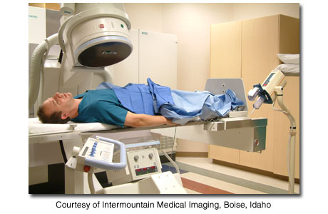
The Fork in the Road
Right Heart Catheterization
Provides valuable information as to which options will be available for treatment
Pulmonary Vascular Resistance (PVR)
PAM-PCWP/CO = PVR

Slide 16
Right Heart Catheterization
PVR </= 3.0
With or without
Challenge
PVR > 3.0
With Challenge
VAD Eval.
RVSWI
Bridge to Transplant
Destination
Therapy
LVAD
Heart Transplant Eval.
Supportive Care

Slide 17
Evaluation
Medical
Multi-system Organ Fcn.
PT, RD, Pharm D, Palliative Care
Psychosocial
Support
Substance Abuse
Financial

Slide 18
Selection Committee
Multi-Disciplinary Team
Completed evaluation presented
Concerns discussed and debated
Democratic vote
Plan of care established
List
VAD
Supportive Care
Need more follow-up

Slide 19

Waitlist
Status 6
At home, optimized therapy, ongoing monitor
Status 4
At home, continuous inotropes
At home, with LVAD
Status 3
LVAD (30 days)
Status 2
Non-dischargeable MCS
Status 1
VA ECMO, bi-ventricular support
Close monitoring:
Clinic visits/labs
RHC Q6months, prn

Slide 20
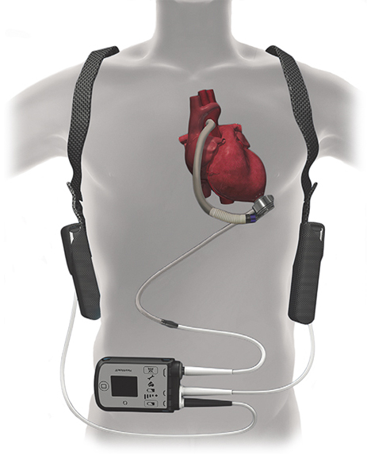
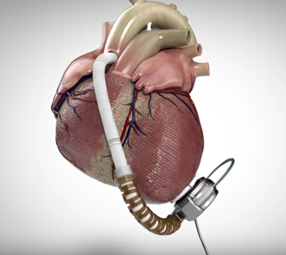
Ventricular Assist Devices

Slide 21
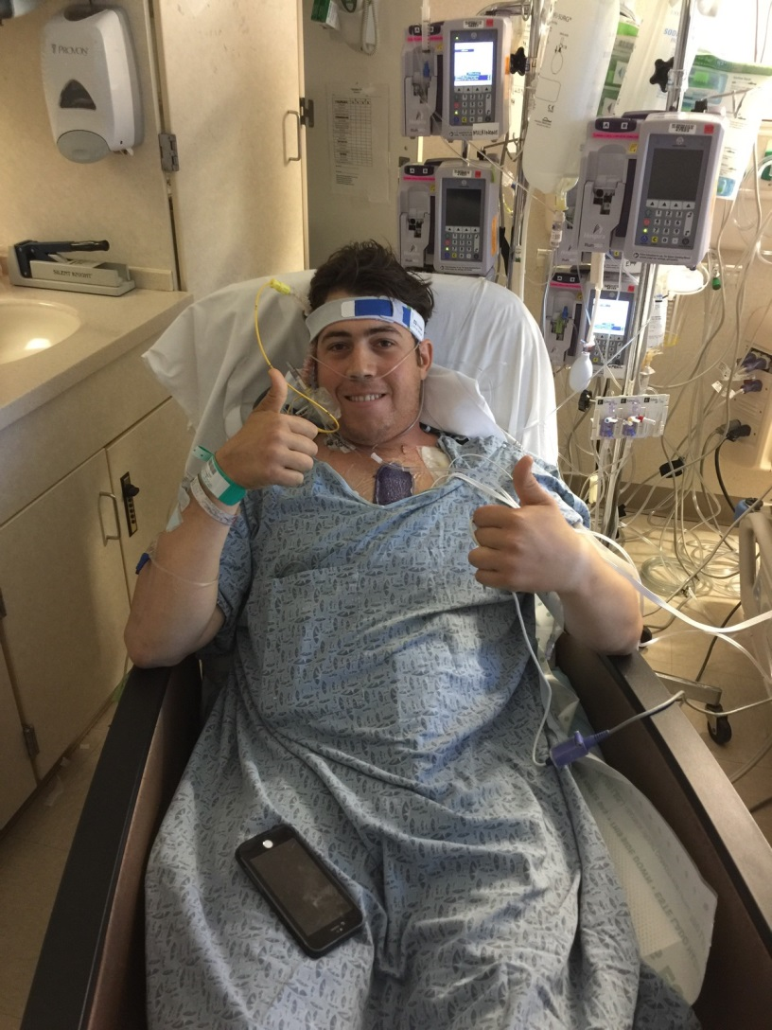

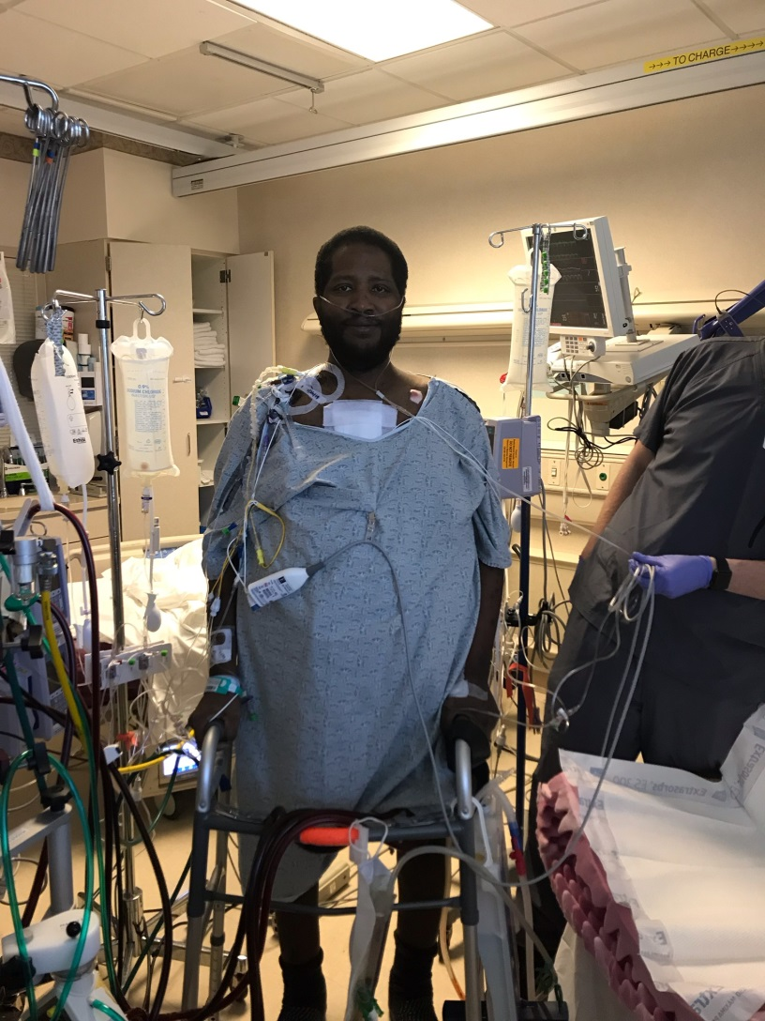
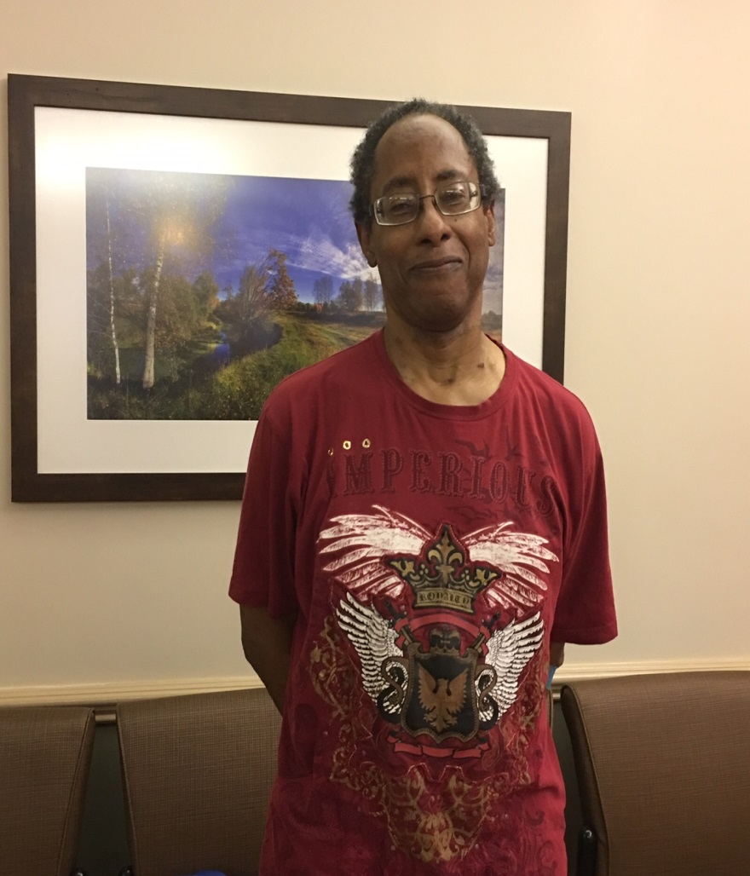
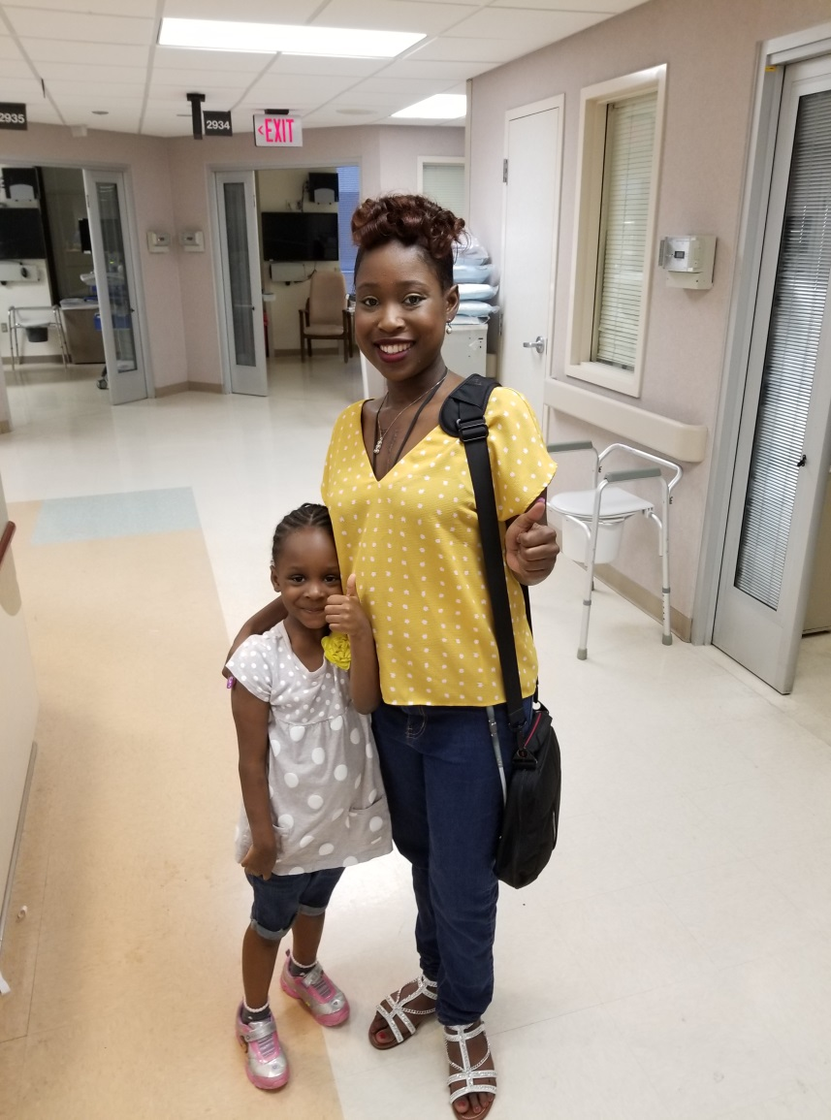
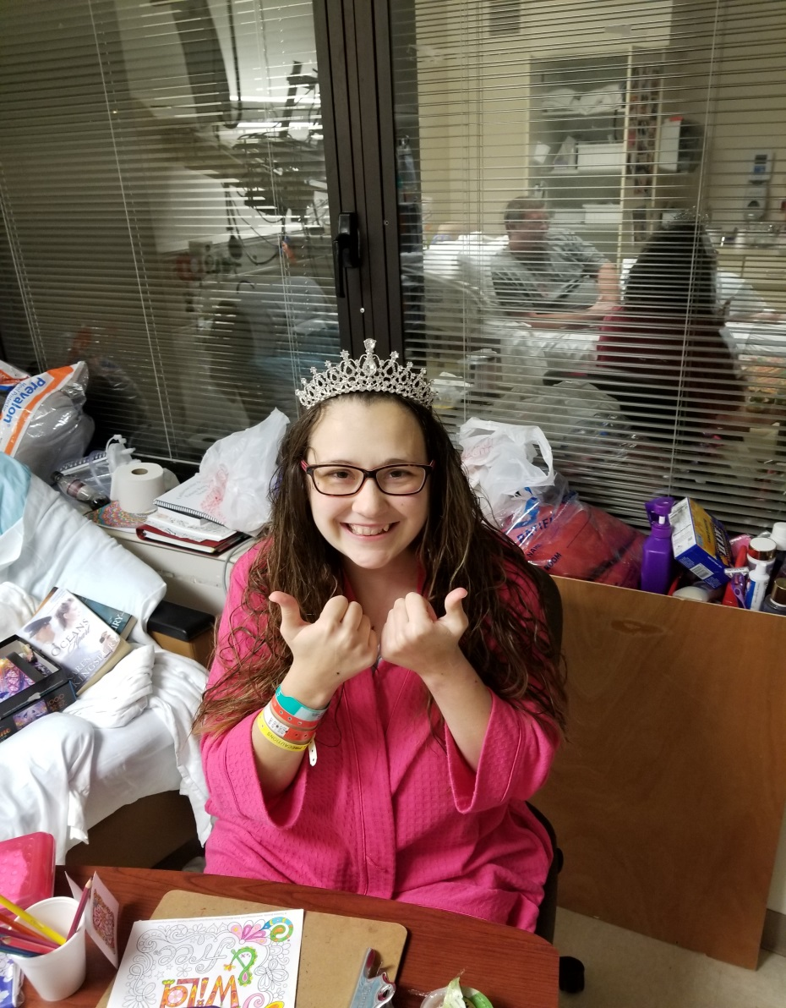
All About the Patients

Slide 22

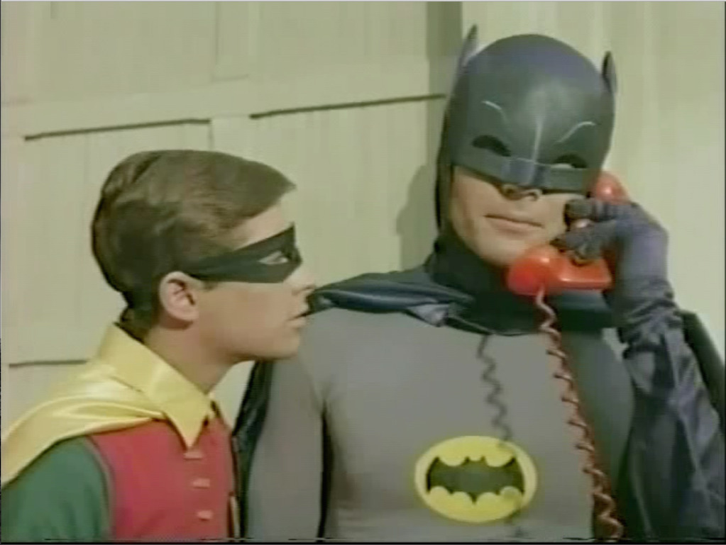
Baptist Advanced Heart Failure Referral Line 901-226-3712
Dr. Todd Edwards
901-378-8749

